Slide 1
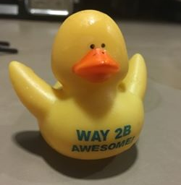
AI Project
Krista Shuckerow
Dale Keith

Slide 2
Strategy Progression
Conditional Logic with Simple Probabilities
Q-Learning
Refined probabilities using Nash equilibrium and different levels of bluffing

Slide 3
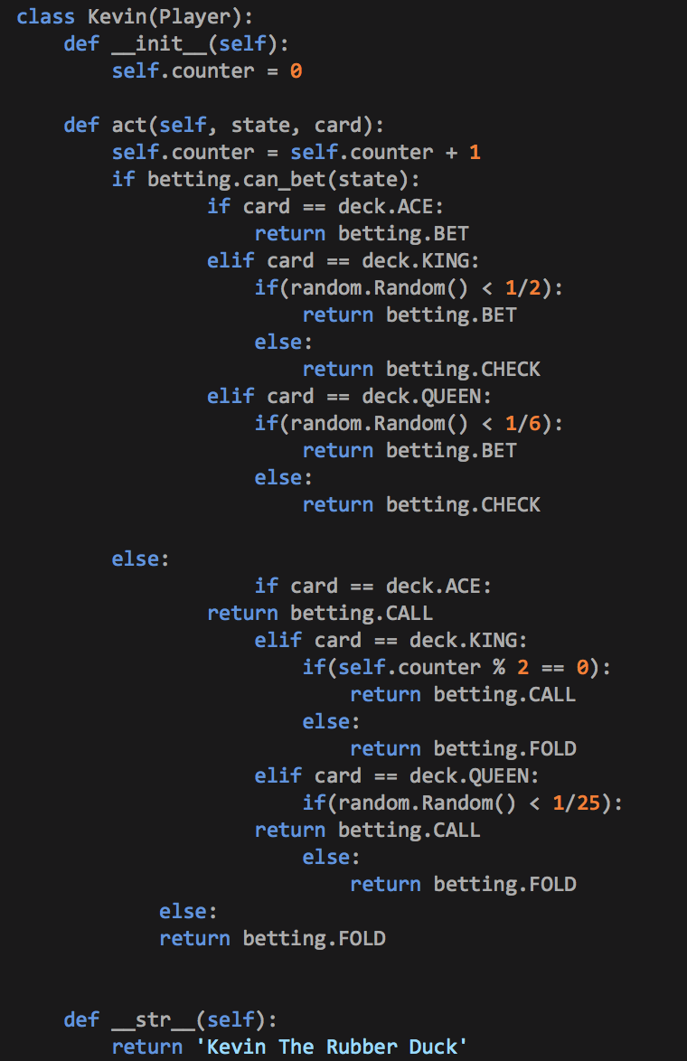
The Final Code

Slide 4


Results

